Slide 1
MAD-II Final Project
Flash-card Web App
by
Tushar Supe (21F1003637)

Slide 2
What is Flashcard ?
A flashcard is a card bearing information on both sides, which is intended to be used as an aid in memorization.
Each flashcard bears a question on one side and an answer on the other.
(ref: https://en.wikipedia.org/wiki/Flashcard)

Slide 3
Modules and Languages:

Slide 4
Database Model:
Table name: deck
Column | Datatype | Constraint | Description
deckid | Integer | Primary key, Autoincrement | Unique deck id for every deck
deckname | String | Not null | Unique deck name for same user id
deckdesc | String | Not null | Description of the deck
ltime | Integer |  | Last reviewed time of deck (time as timestamp)
lscore | Float |  | Last reviewed score of the deck
oscore | Float |  | Overall score of the deck
userid | Integer | ForeignKey("users.userid"), Not null | To link user to deck
Table name: cards
Column | Datatype | Constraint | Description
cardid | Integer | Primary key, Autoincrement | Unique card id for every card
question | String | Not null | Front side of card, must be unique per deck
answer | String | Not null | Back side of the card
ltime | Integer |  | Last reviewed time of card (time as timestamp)
lscore | Float |  | Last reviewed score of a card
deckid | Integer | ForeignKey("deck.deckid"), Not null | To link card to deck

Slide 5
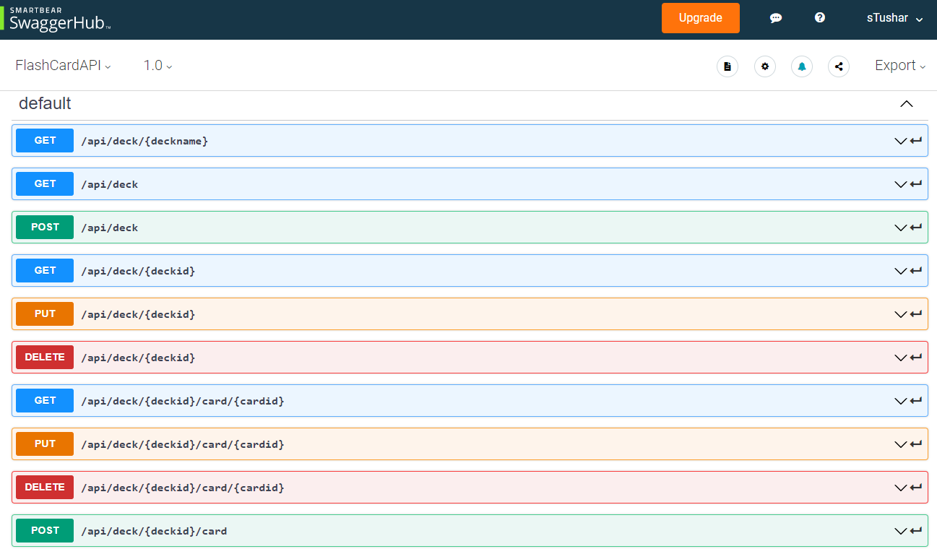
REST API:

Slide 6
REST API:
Resource | Request | Endpoint | Request body | Purpose (for current user)
Deck | GET | /api/deck | - | To get details of all decks
Deck | POST | /api/deck | deckname, deckdesc | To create a new deck
Deck | GET | /api/deck/<int:deckid> | - | To get deck details
Deck | PUT | /api/deck/<int:deckid> | deckdesc | To update deck description
Deck | PUT | /api/deck/<int:deckid> | ltime, lscore | To update last reviewed time, score of deck
Deck | DELETE | /api/deck/<int:deckid> | - | To delete a deck
Deck | GET | /api/deck/<string:deckname> | - | To get deckid from deckname
Cards | GET | /api/deck/<int:deckid>/card/<int:cardid> | - | To get single card details
Cards | PUT | /api/deck/<int:deckid>/card/<int:cardid> | question, answer | To update front and back details of a card
Cards | PUT | /api/deck/<int:deckid>/card/<int:cardid> | ltime, lscore | To update last reviewed time and score of a card
Cards | DELETE | /api/deck/<int:deckid>/card/<int:cardid> | - | To delete a card
Cards | POST | /api/deck/<int:deckid>/card | question, answer | To create a new card

Slide 7
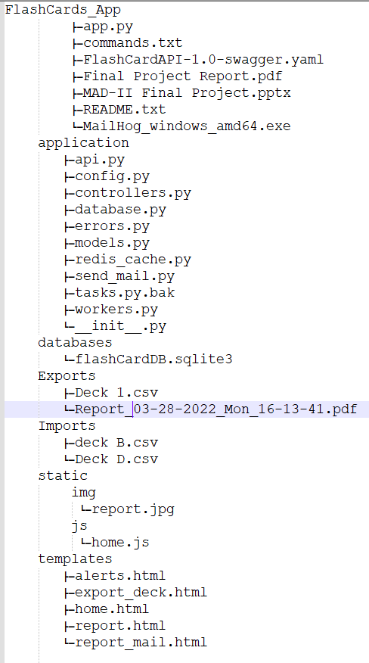
Files Tree diagram:

Slide 8
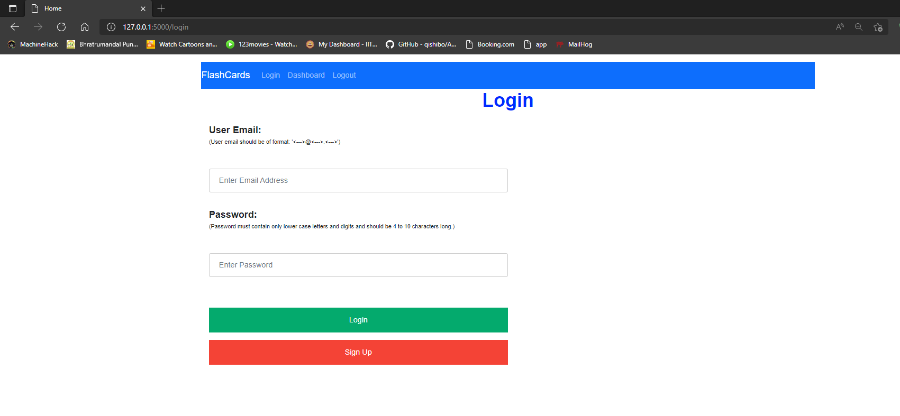
Login Page :

Slide 9
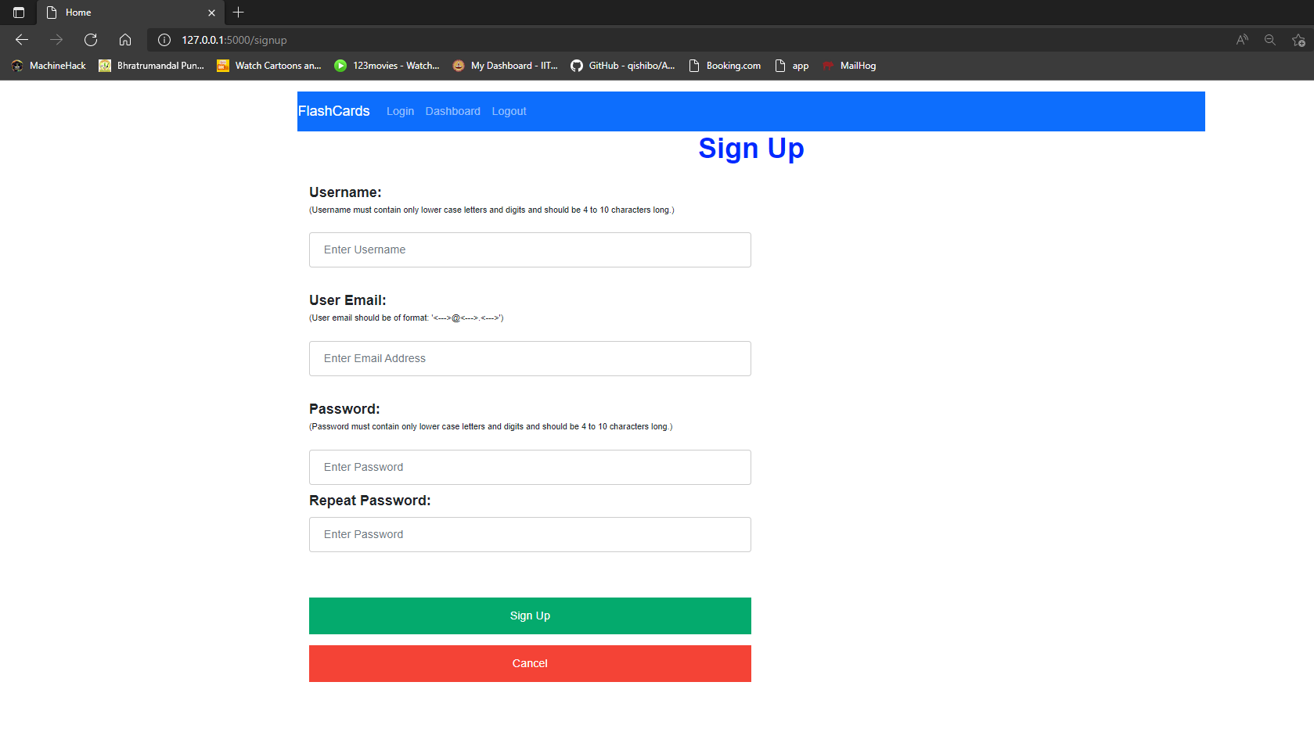
Sign Up Page :

Slide 10
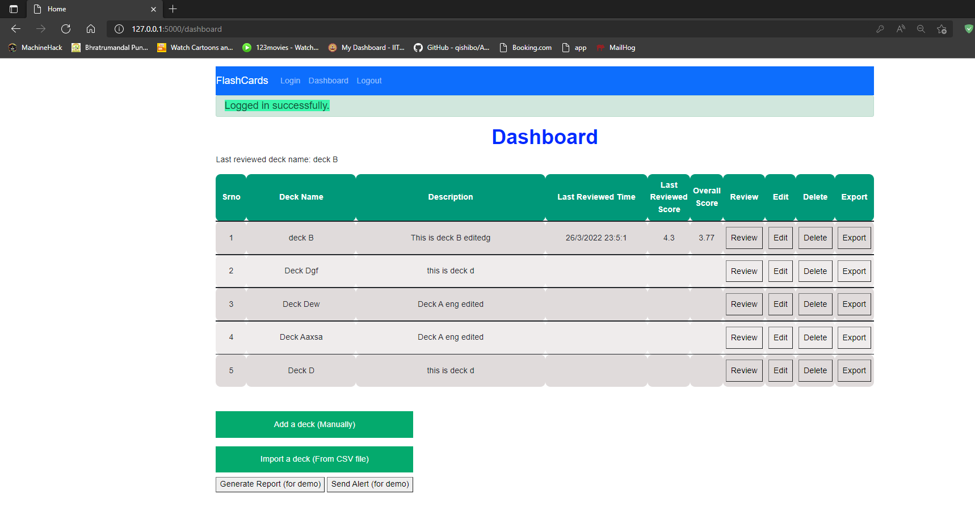
Dashboard Page :

Slide 11
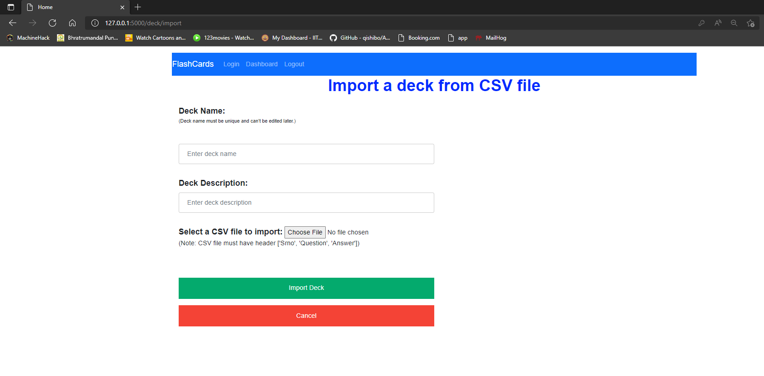
Import Deck Page :

Slide 12
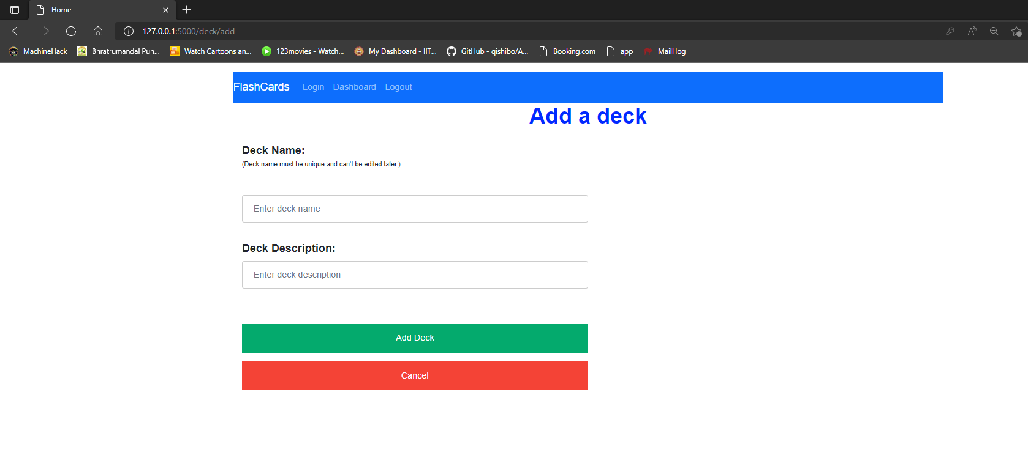
Add Deck Page :

Slide 13
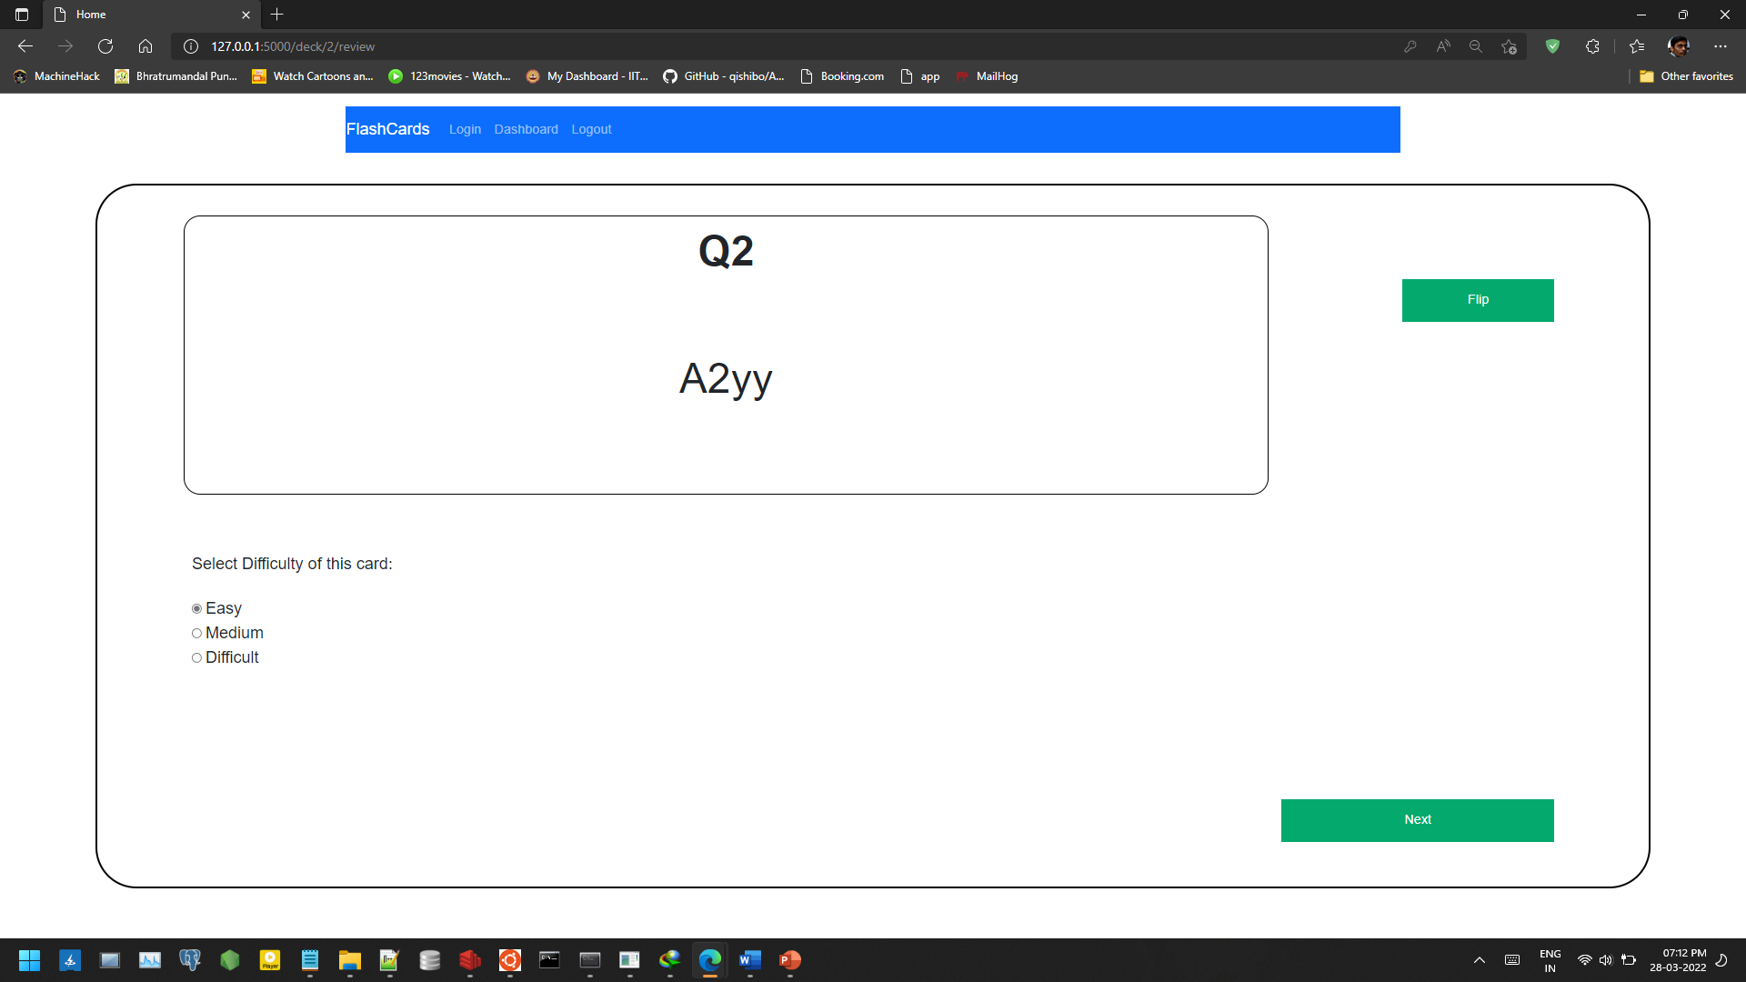
Review Deck Page:

Slide 14
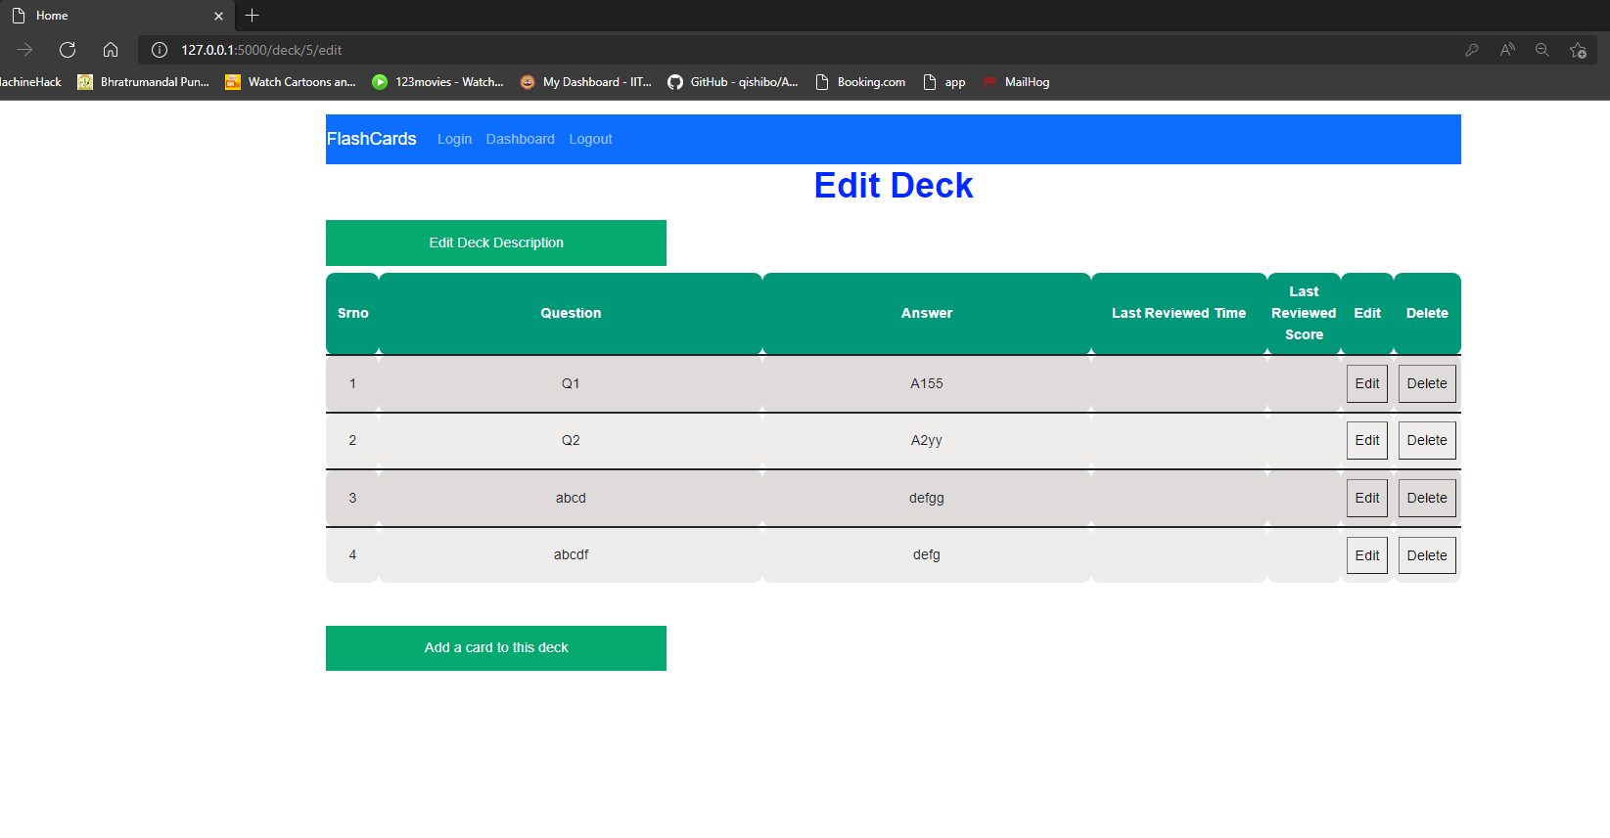
Edit Deck Page :

Slide 15
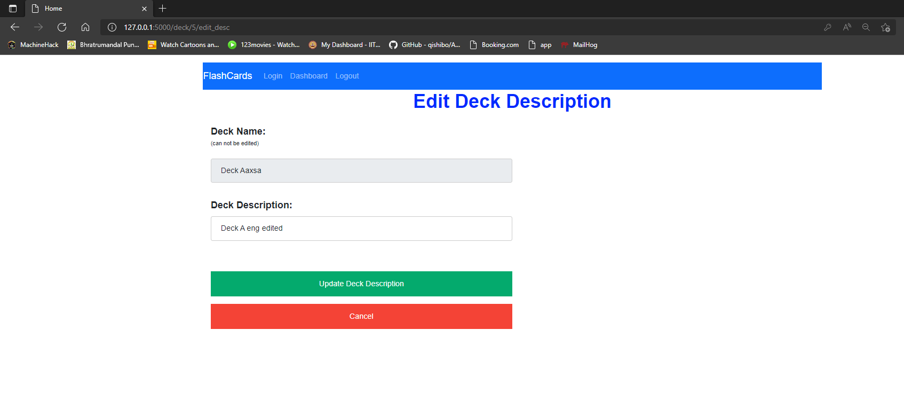
Edit Deck Description Page :

Slide 16
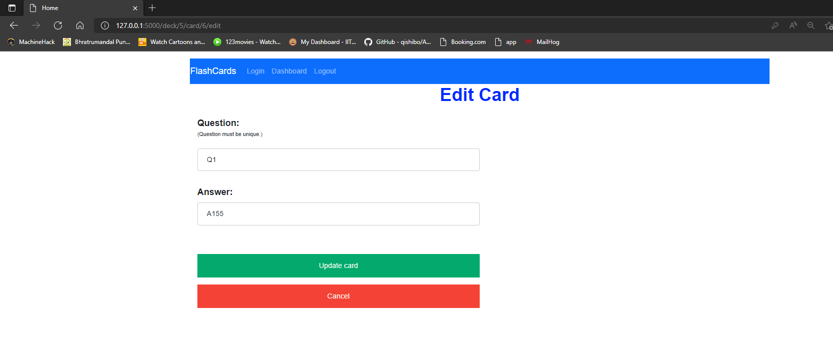
Edit Card Page :

Slide 17
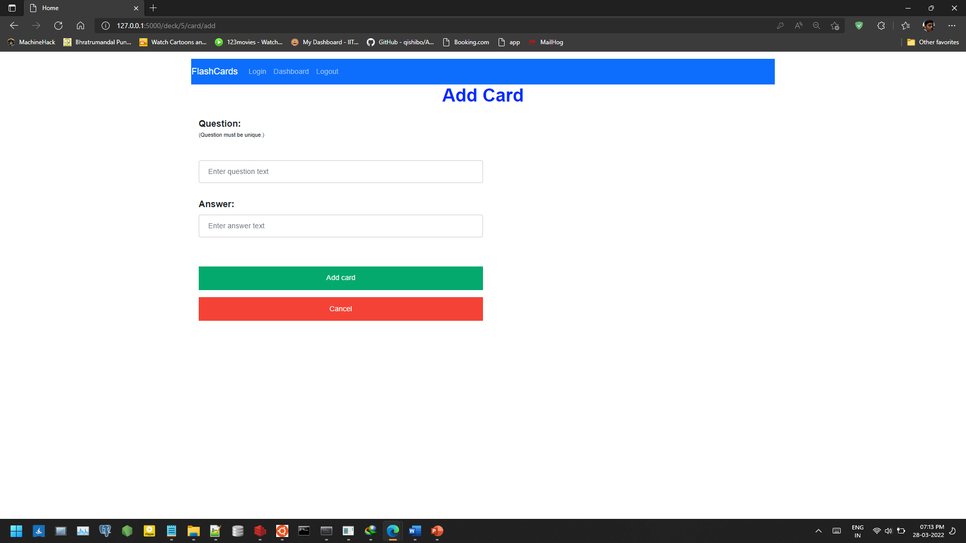
Add Card Page:

Slide 18
Features:
Basic UI with Vue (it’s a SPA)
Deck and card management (CRUD) with RESTful api
User login and all api request with JWT token authentication
Daily reminder with Google Chat webhook and email alerts
Monthly report generation and emailing
Import and export decks (.csv format)
Caching basic data like user details, tokens Proper login system
Multi language support
Minimalist design

Slide 19
Thank you !!

